Slide 1


做好开源客服系统
行动号召：给春松客服 Star
github.com/chatopera/cskefu
分享内容在 5 秒后开始

Slide 2


春松客服大讲堂
2019 © 北京华夏春松科技有限公司

Slide 3

春松客服大讲堂
做好开源客服系统
Java的基础知识
王海良
主讲老师/华夏春松联合创始人&CEO
Chatopera 用户群
春松客服，Chatopera 机器人平台用户讨论群
2019 © 北京华夏春松科技有限公司

Slide 4

自我介绍
王海良，Chatopera联合创始人&CEO，微软人工智能
最有价值专家。2011年毕业于北邮，后加入IBM工作四
年，先后工作于软件开发实验室和创新中心。从2016年
开始工作于创业公司，三角兽AI算法工程师，呤呤英语
AI产品负责人，负责智能对话系统研发，2018年出版
《智能问答与深度学习》一书。

Slide 5
分享大纲
春松客服大讲堂
5.2 Java的基础知识
基本数据类型和语法
反射和切面编程
面向对象编程
Java设计模式
Notes:
演示代码库：
https://github.com/Samurais/java-get-started

Slide 6
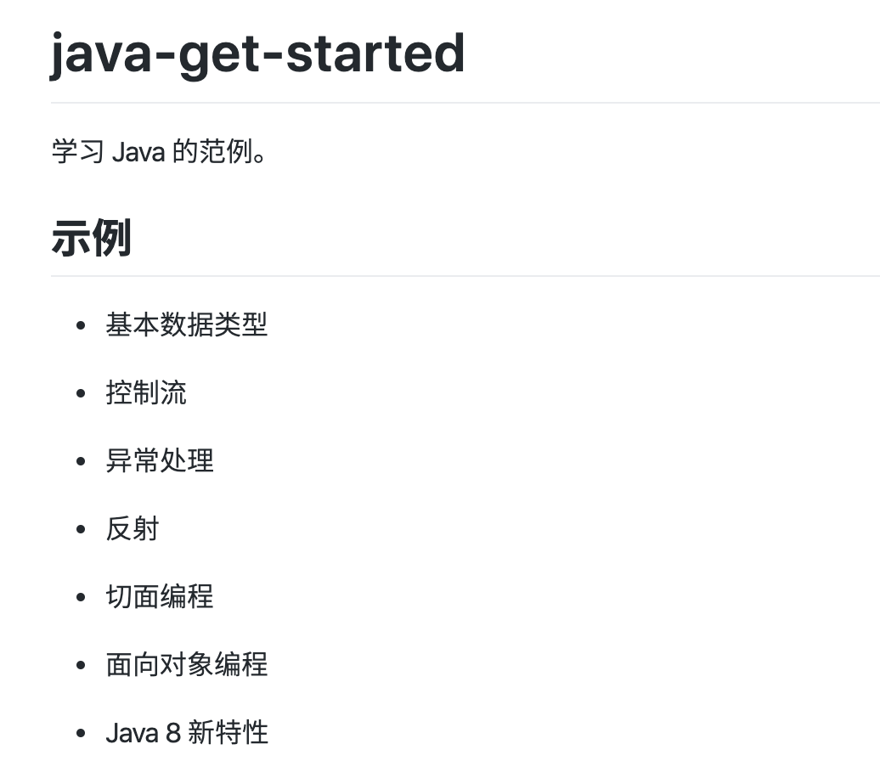
示例代码
春松客服大讲堂
5.2 Java的基础知识
A set of examples to learning Java.
https://github.com/Samurais/java-get-started
Notes:
演示代码库：
https://github.com/Samurais/java-get-started

Slide 7
基本数据类型和语法
春松客服大讲堂
5.2 Java的基础知识

Slide 8
Java简介
春松客服大讲堂
5.2 Java的基础知识
Java是由Sun Microsystems公司于1995年5月推出的Java面向对象程序设计语言和Java平台的总称。由James Gosling和同事们共同研发，并在1995年正式推出。

Slide 9
Java发展历史
春松客服大讲堂
5.2 Java的基础知识
微软雅黑
一级字号44
二级字号40
三级字号28
三级以下字号22
Notes:
https://www.geeksforgeeks.org/the-complete-history-of-java-programming-language/

Slide 10
Java Application
春松客服大讲堂
5.2 Java的基础知识
Compiled by
generates
Sample.java
(Java sourcecode)
Java
Compiler
Sample.class
(Java bytecode executable file)
Library
Code
Application
Execute by JVM
JVM
Notes:
https://howtodoinjava.com/java/basics/jdk-jre-jvm/
Java Virtual machine (JVM) is the virtual machine that runs the Java bytecodes. You get this bytecode by compiling the .java files into .class files. .class files contain the bytecodes understood by the JVM.
In the real world, JVM is a specification that provides a runtime environment in which Java bytecode can be executed. Different vendors provide different implementations of this specification. For example, this wiki page lists down different JVM implementations.
Most popular implementation of JVM is Hotspot which is owned and provided by Oracle Corporation. (Previously by Sun Microsystems, Inc.).
JVM delivers the optimal performance for Java applications using many advanced techniques, incorporating a state-of-the-art memory model, garbage collector, and adaptive optimizer.

Slide 11
JVM Architecture
春松客服大讲堂
5.2 Java的基础知识
Class Loader
JVM Language Classes
Method Area
Heap
JVM Language Stacks
PC Reisters
Native Method Stacks
Exectution Engine
Native Method Interface
Native Method Libraries
Notes:
https://howtodoinjava.com/java/basics/jdk-jre-jvm/
2.1.1. Class Loader
The class loader is a subsystem used for loading class files. It performs three major functions i.e. class loading, linking, and initialization.
Loading
To load classes, JVM has 3 kind of class loaders. Bootstrap, extension and application class loader.
When loading a class file, JVM finds out a dependency for some arbitrary class XYZ.class.
First bootstrap class loader tries to find the class. It scans the rt.jar file in JRE lib folder.
If class is not found then extension class loader searches the class file in inside jre\lib\ext folder.
Again if class is not found then application classloader searches all the Jar files and classes in CLASSPATH environment variable of system.
If class is found by any loader then class is loaded by class loader; else ClassNotFoundException is thrown.
Linking
After class is loaded by the classloader, linking is performed. A bytecode verifier will verify whether the generated bytecode is proper or not if verification fails we will get a verification error. It also performs the memory allocation to static variables and methods found in the class.
Initialization
This is the final phase of class loading, here all static variable will be assigned with the original values and the static blocks will be executed.
2.1.2. JVM Memory Areas
Memory area inside JVM is divided into multiple parts to store specific parts of application data.
Method Area stores class structures like metadata, the constant runtime pool, and the code for methods.
Heap stores all objects that are created during application execution.
Stacks store local variables, and intermediate results. All such variables are local to the thread by which they are created. Each thread has its own JVM stack, created simultaneously as the thread is created. So all such local variable are called thread-local variables.
PC register store the physical memory address of the statements which is currently executing. In Java, each thread has its separate PC register.
Java supports and uses native code as well. Many low level code is written in languages like C and C++. Native method stacks hold the instruction of native code.
2.2. JVM Execution Engine
All code assigned to JVM is executed by an execution engine. The execution engine reads the byte code and executes one by one. It uses two inbuilt interpreter and JIT compiler to convert the bytecode to machine code and execute it.

Slide 12
JDK, JRE and JVM
春松客服大讲堂
5.2 Java的基础知识
JDK
JRE
Development Tools
JVM
Libraries
Notes:
5. Differences between JDK, JRE and JVM
Based on the above discussions, we can draw a relationship between these three as below –
JRE = JVM + libraries to run Java application.
JDK = JRE + tools to develop Java Application.
JDK is a superset of JRE. JDK contains everything that JRE has along with development tools for developing, debugging, and monitoring Java applications. You need JDK when you need to develop Java applications.
Few important components shipped with JDKs are as follows:
appletviewer – this tool can be used to run and debug Java applets without a web browser
apt – the annotation-processing tool
extcheck – a utility that detects JAR file conflicts
javadoc – the documentation generator, which automatically generates documentation from source code comments
jar – the archiver, which packages related class libraries into a single JAR file. This tool also helps manage JAR files
jarsigner – the jar signing and verification tool
javap – the class file disassembler
javaws – the Java Web Start launcher for JNLP applications
JConsole – Java Monitoring and Management Console
jhat – Java Heap Analysis Tool
jrunscript – Java command-line script shell
jstack – utility that prints Java stack traces of Java threads
keytool – tool for manipulating the keystore
policytool – the policy creation and management tool
xjc – Part of the Java API for XML Binding (JAXB) API. It accepts an XML schema and generates Java classes
Same as JREs, JDKs are also platform dependent. So take care when you download the JDK package for your machine.

Slide 13
基础数据类型
春松客服大讲堂
5.2 Java的基础知识
String
Boolean
int
……
Notes:
1、HashMap是线程不安全的，在多线程环境下会容易产生死循环，但是单线程环境下运行效率高；Hashtable线程安全的，很多方法都有synchronized修饰，但同时因为加锁导致单线程环境下效率较低。
2、HashMap允许有一个key为null，允许多个value为null；而Hashtable不允许key或者value为null。
如果你觉得会到处这两点就对HashMap、HashTable有很深的了解的话，那就大错特错！本文将基于JDK1.8的HashMap和Hashtable的源码进行详细的比较。

Slide 14
控制流
春松客服大讲堂
5.2 Java的基础知识
逻辑控制
if else
……
Notes:
https://lw900925.github.io/java/java8-lambda-expression.html
1) flowcontrol

Slide 15
异常处理
春松客服大讲堂
5.2 Java的基础知识
Throwable
Exception
Error
RuntimeException
Any class besides
RuntimeExcception
Any subclass
Any Subclass
Any Subclass
A Checked throwable
An Unchecked throwable
Notes:
Before looking at the difference between java.lang.RuntimeException and java.lang.Exception classes, you must know the Exception hierarchy. Both Exception and Error classes are derived from class Throwable (which derives from the class Object). And the class RuntimeException is derived from class Exception.
All the exceptions are derived either from Exception or RuntimeException.
All the exceptions which derive from RuntimeException are referred to as unchecked exceptions. And all the other exceptions are checked exceptions. A checked exception must be caught somewhere in your code, otherwise, it will not compile. That is why they are called checked exceptions. On the other hand, with unchecked exceptions, the calling method is under no obligation to handle or declare it.
Therefore all the exceptions which compiler forces you to handle are directly derived from java.lang.Exception and all the other which compiler does not force you to handle are derived from java.lang.RuntimeException.
Following are some of the direct known s
https://stackoverflow.com/questions/2190161/difference-between-java-lang-runtimeexception-and-java-lang-exception

Slide 16
异常处理
春松客服大讲堂
5.2 Java的基础知识
java.lang
throwable
error
Exception
Checked exception
Unchecked exception
ClassNotFoundException
FileNotFoundException
IOException
InterruptedException
NullPointerException
NosuchFieldExcception
NosuchMethodException
Notes:
https://stackoverflow.com/questions/2190161/difference-between-java-lang-runtimeexception-and-java-lang-exception

Slide 17
异常处理
春松客服大讲堂
5.2 Java的基础知识
try catch
……
Notes:
1) exceptionhandling
https://stackoverflow.com/questions/2190161/difference-between-java-lang-runtimeexception-and-java-lang-exception

Slide 18
关键字
春松客服大讲堂
5.2 Java的基础知识
static
声明在编译时已经明确
静态方法，静态变量，静态块，静态嵌套类
final
锁定引用，类
final 关键字可以修饰类，方法和变量
Notes:
1) keywords
https://lw900925.github.io/java/java8-lambda-expression.html
当用final修饰一个类时，表明这个类不能被继承。也就是说，如果一个类你永远不会让他被继承，就可以用final进行修饰。final类中的成员变量可以根据需要设为final，但是要注意final类中的所有成员方法都会被隐式地指定为final方法。Java中的String类就是一个final类。
在使用final修饰类的时候，要注意谨慎选择，除非这个类真的在以后不会用来继承或者出于安全的考虑，尽量不要将类设计为final类。
“使用final方法的原因有两个。第一个原因是把方法锁定，以防任何继承类修改它的含义；第二个原因是效率。在早期的Java实现版本中，会将final方法转为内嵌调用。但是如果方法过于庞大，可能看不到内嵌调用带来的任何性能提升。在最近的Java版本中，不需要使用final方法进行这些优化了。“
修饰变量是final用得最多的地方，也是本文接下来要重点阐述的内容。首先了解一下final变量的基本语法：
对于一个final变量，如果是基本数据类型的变量，则其数值一旦在初始化之后便不能更改；如果是引用类型的变量，则在对其初始化之后便不能再让其指向另一个对象。

Slide 19
Java 8 新特性
春松客服大讲堂
5.2 Java的基础知识
Lambda
Function
Optional
Notes:
1) java8
https://lw900925.github.io/java/java8-lambda-expression.html
2014年3月发布的Java 8，有可能是Java版本更新中变化最大的一次。新的Java 8为开发者带来了许多重量级的新特性，包括Lambda表达式，流式数据处理，新的Optional类，新的日期和时间API等。这些新特性给Java开发者带来了福音，特别是Lambda表达式的支持，使程序设计更加简化。本篇文章将讨论行为参数化，Lambda表达式，函数式接口等特性。

Slide 20
反射和切面编程
春松客服大讲堂
5.2 Java的基础知识
Notes:
https://medium.com/@hinchman_amanda/oop-metaprogramming-series-java-reflection-and-aop-6f63b23f0b05
What is Reflection?
Reflection is a programming technique that allows us to examine and even modify the structure of objects at run-time. The Java Reflection API enhanced Java Class with self-inspecting methods such as:
[Class].getMethods() — the methods that are returned includes not only the declared methods but also the inherited methods
[Class].getDeclaredMethods() — returns only declared methods
[Class].getReturnType() — returns the return type of for each method. Output includes fully qualified name of the class, which means that it includes the package name (i.e. java.lang.Double)
[Class].getModifiers() — returns as ints. Converting a string gives you the method signature
The following methods enhance the Java Class by retrieving information that may allow functions such presenting information in the compiler, and generating compile-time, deployment-time processing or runtime processing.

Slide 21
反射
春松客服大讲堂
5.2 Java的基础知识
Reflection is a feature in the Java programming language. It allows an executing Java program to examine or "introspect" upon itself, and manipulate internal properties of the program. For example, it's possible for a Java class to obtain the names of all its members and display them.
Notes:
https://powerdream5.wordpress.com/2007/10/08/applying-java-reflection-to-ioc-and-aop-2/

Slide 22
AspectJ
春松客服大讲堂
5.2 Java的基础知识
AspectJ is an aspect-oriented programming (AOP) extension created for the Java programming language.
AOP
Join point
Advice
Pointcut
Weaving
Target Object
Aspect
Proxy
Notes:
https://www.eclipse.org/aspectj/

Slide 23
Notes:
Get started with AOP
http://esus.com/get-started-with-aspectj/
https://www.eclipse.org/aspectj/downloads.php
https://medium.com/@hinchman_amanda/oop-metaprogramming-series-java-reflection-and-aop-6f63b23f0b05

Slide 24
反射，AOP
春松客服大讲堂
5.2 Java的基础知识
Method.invoke
…
Notes:
Reflection
AOP: ajc, …
Aspectj: Pom, aop.xml, …

Slide 25
面向对象编程
春松客服大讲堂
5.2 Java的基础知识
Notes:
https://raygun.com/blog/oop-concepts-java/
# Abstraction:
With abstraction, you can hide the internal workings of an object and only show the features the user needs to know about. Java provides two ways to implement abstraction: abstract classes and interfaces. With abstract classes, you can achieve partial abstraction, while interfaces make total (100%) abstraction possible.
Abstract classes(An abstract class is a superclass (parent class) that cannot be instantiated. You need to instantiate one of its child classes if you want to create a new object. Abstract classes can have both abstract and concrete methods. Abstract methods contain only the method signature, while concrete methods declare a method body as well. Abstract classes are defined with the abstract keyword.), Interfaces(An interface is a 100% abstract class. It can have only static, final, and public fields and abstract methods. It’s frequently referred to as a blueprint of a class as well. Java interfaces allow us to implement multiple inheritance in our code, as a class can implement any number of interfaces. Classes can access an interface using the implements keyword.)
# Encapsulation: With encapsulation, you can protect the fields of a class. To do so, declare the fields as private and providing access to them with getter and setter methods.
# Inheritance: Inheritance allows us to extend a class with child classes that inherit the fields and methods of the parent class. It’s an excellent way to achieve code reusability. In Java, we need to use the extends keyword to create a child class.
# Polymorphism: Static polymorphism(Method overloading means that you can have several methods with the same name within a class. However, the number, names, or types of their parameters need to be different.), Dynamic polymorphism(By using the method overriding feature of Java, you can override the methods of a parent class from its child class.)

Slide 26
抽象（Abstraction）
春松客服大讲堂
5.2 Java的基础知识
Abstraction hides complexity from the user and shows only the relevant information. The details of an abstract method are implemented separately by each class.
Notes:
Abstraction aims to hide complexity from the users and show them only the relevant information. For example, if you want to drive a car, you don’t need to know about its internal workings. The same is true of Java classes. You can hide internal implementation details by using abstract classes or interfaces. On the abstract level, you only need to define the method signatures (name and parameter list) and let each class implement them in their own way.
Hides the underlying complexity of data
Helps avoid repetitive code
Presents only the signature of internal functionality
Gives flexibility to programmers to change the implementation of the abstract behaviour
Partial abstraction (0-100%) can be achieved with abstract classes
Total abstraction (100%) can be achieved with interfaces

Slide 27
封装（Encapsulation）
春松客服大讲堂
5.2 Java的基础知识
Encapsulation binds data and its related methods together within a class. It also protects the data by making fields private and giving access to them only through their related methods.
Notes:
Encapsulation allows us to protect the data stored in a class from system-wide access. As its name suggests, it safeguards the internal contents of a class like a real-life capsule. You can implement encapsulation in Java by keeping the fields (class variables) private and providing public getter and setter methods to each of them. Java Beans are examples of fully encapsulated classes.
Restricts direct access to data members (fields) of a class.
Fields are set to private
Each field has a getter and setter method
Getter methods return the field
Setter methods let us change the value of the field

Slide 28
继承（Inheritance）
春松客服大讲堂
5.2 Java的基础知识
Inheritance allows a class (child class) to inherit the features (fields and methods) of another class (parent class). In Java, a class can only extend one other class.
Notes:
Inheritance makes it possible to create a child class that inherits the fields and methods of the parent class. The child class can override the values and methods of the parent class, however it’s not necessary. It can also add new data and functionality to its parent. Parent classes are also called superclasses or base classes, while child classes are known as subclasses or derived classes as well. Java uses the extends keyword to implement the principle of inheritance in code.
Inheritance in Java:
A class (child class) can extend another class (parent class) by inheriting its features.
Implements the DRY (Don’t Repeat Yourself) programming principle.
Improves code reusability.
Multilevel inheritance is allowed in Java (a child class can have its own child class as well).
Multiple inheritances are not allowed in Java (a class can’t extend more than one class).

Slide 29
多态（Polymorphism）
春松客服大讲堂
5.2 Java的基础知识
Polymorphism makes it possible to use the same code structure in different forms. Java classes can have various of the same method if their parameter structures are different.
Notes:
Polymorphismrefers to the ability to perform a certain action in different ways. In Java, polymorphism can take two forms: method overloading and method overriding. Method overloading happens when various methods with the same name are present in a class. When they are called they are differentiated by the number, order, and types of their parameters. Method overriding occurs when the child class overrides a method of its parent.
Polymorphism in Java:
* The same method name is used several times.
* Different methods of the same name can be called from the object. * All Java objects can be considered polymorphic (at the minimum, they are of their own type and instances of the Object class). * Example of static polymorphism in Java is method overloading. * Example of dynamic polymorphism in Java is method overriding.

Slide 30
面向对象
春松客服大讲堂
5.2 Java的基础知识
Animal
Fish
Bird
…
Notes:
Reflection
AOP: ajc, …
Aspectj: Pom, aop.xml, …

Slide 31
Java设计模式
春松客服大讲堂
5.2 Java的基础知识

Slide 32
文字要求
春松客服大讲堂
5.2 Java的基础知识
微软雅黑
一级字号44
二级字号40
三级字号28
三级以下字号22

Slide 33
洋葱模型
春松客服大讲堂
5.2 Java的基础知识
微软雅黑
Composer composer = new Composer<SampleContext>();
composer.use(new Mw1());
composer.use(new Mw2());
SampleContext context = new SampleContext();
composer.handle(context);
print(context.getData());
一级字号44
二级字号40
三级字号28
三级以下字号22
https://github.com/chatopera/compose4j

Slide 34
演示代码
春松客服大讲堂
5.2 Java的基础知识
单例模式
洋葱模式
Notes:
https://dzone.com/articles/singleton-in-java
https://dzone.com/articles/singleton-in-java
https://github.com/chatopera/compose4j
https://www.journaldev.com/1377/java-singleton-design-pattern-best-practices-examples

Slide 35
延伸阅读
春松客服大讲堂
5.2 Java的基础知识
Notes:
https://dzone.com/articles/singleton-in-java
https://dzone.com/articles/singleton-in-java
https://github.com/chatopera/compose4j
https://www.journaldev.com/1377/java-singleton-design-pattern-best-practices-examples

Slide 36
代码阅读提示
春松客服大讲堂
5.2 Java的基础知识

Slide 37
代码结构
春松客服大讲堂
5.2 Java的基础知识
Templates
Controller
Proxy
Model
Database

Slide 38


做好开源客服系统
Chatopera 公众号
Chatopera 用户群
最新更新，动态
春松客服，Chatopera 机器人平台用户讨论群
2019 © 北京华夏春松科技有限公司

Slide 39
资源
文档中心: https://docs.chatopera.com
开源地址: http://github.com/chatopera
春松客服: https://github.com/chatopera/cskefu
博客地址: https://blog.chatopera.com
Chatopera云服务: https://bot.chatopera.com/
2019 © 北京华夏春松科技有限公司

